Slide 1
Long Run: The Optimal Input Mix
Module 3 · Video 5
Management 405
Prof. Nico Voigtländer · UCLA Anderson

Slide 2
Module 3 · Agenda
Outline of Module 3
1
Introduction to Module 3
Video 1
2
The Production Function
Video 2
3
Short Run: Hiring Decisions
Video 3
4
Wage Searchers
Video 4
5
Long Run: The Optimal Input Mix
Choosing between capital and labor when both can be adjusted
Video 5
6
Cost Concepts
Video 6
7
Economies of Scale and Scope
Video 7
Management 405 · Module 3 · Production and Costs
2
Notes:
We now switch gears, from the short run to the long run. In the short run capital was stuck, and labor was our only lever. In the long run nothing is fixed. We get to choose both capital and labor from scratch. That opens a new question. What is the right mix of capital and labor to use? That is what the next several slides work out.

Slide 3
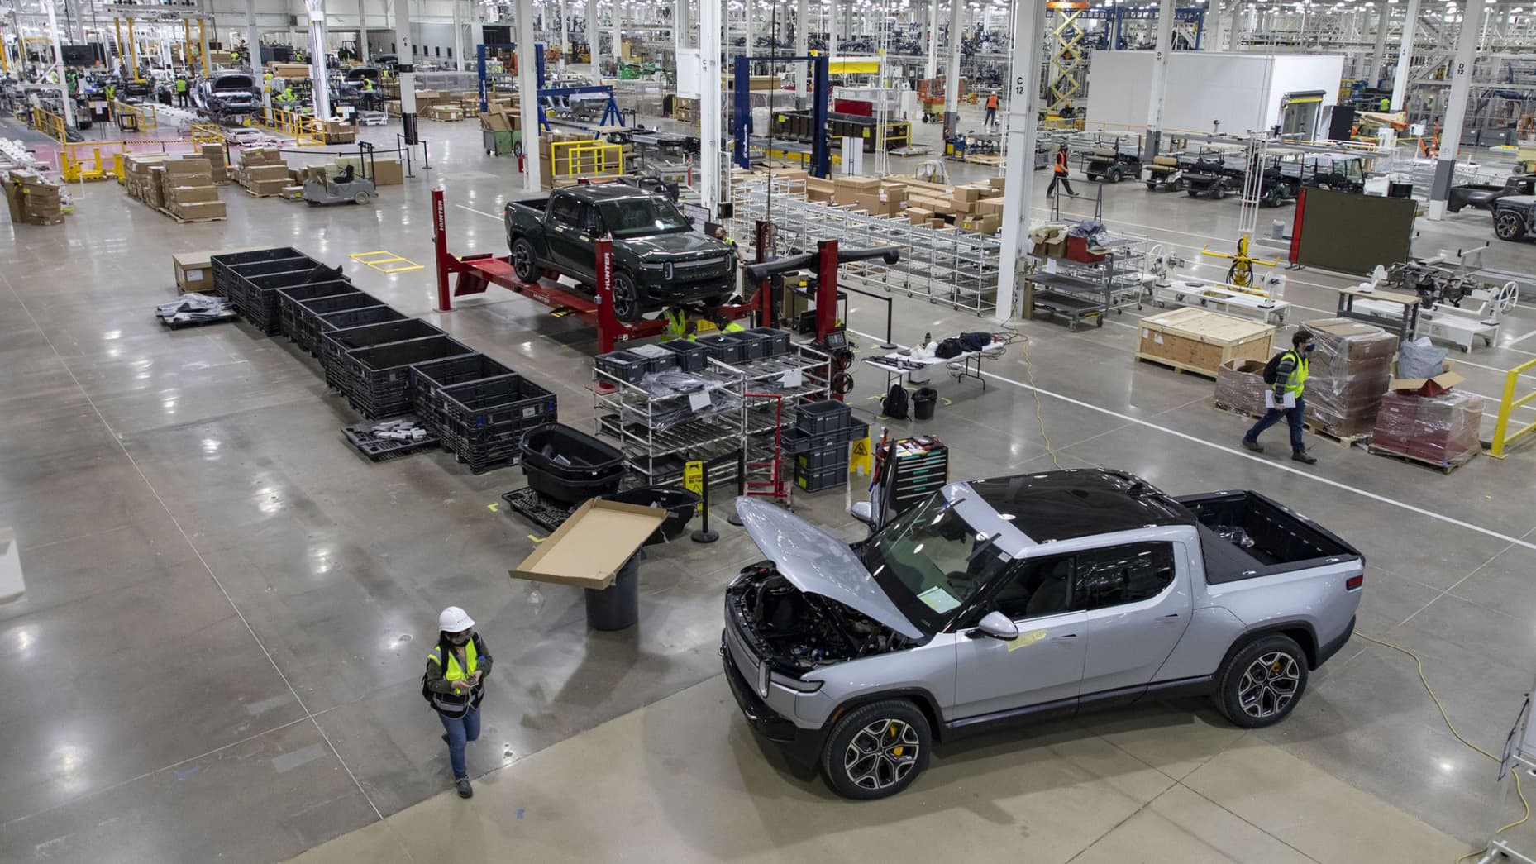
Module 3 · Long Run: The Optimal Input Mix
Long Run: Rivian Builds a New Georgia Plant
Context: Rivian builds its new Georgia plant
Both capital and labor are flexible inputs
What is the optimal input mix?
E.g., robots (K) and workers (L)
We will:
Use marginal analysis
Learn a simple rule for the optimal combination of inputs
Brian Cassella | Tribune News Service | Getty Images
Long run ⇒ pick the optimal K-and-L mix
Management 405 · Module 3 · Production and Costs
3
Notes:
Here is the concrete setting for the long-run problem. Rivian is building a brand-new plant in Stanton Springs, Georgia. Because it is a clean sheet, both inputs are flexible. Rivian gets to choose the plant size, the machinery, and the workforce all at once. So the question is no longer how many workers to add to a fixed factory. It is what is the best mix of robots and workers to build cars. Over the next few slides we use marginal analysis to reach a simple rule for that optimal combination.

Slide 4

Module 3 · Long Run: The Optimal Input Mix
Optimal Combination of Inputs
Optimal Input Mix: How much K and how much L?
Decision rule for the long run:
$$\frac{{MP}_{K}}{p_{K}} = \frac{{MP}_{L}}{w}$$
MP_{K} : Marginal Product of Capital
MP_{L} : Marginal Product of Labor
pₖ : Price of Capital
w : Wage
Bang for the Buck Rule
Holds when both L and K are flexible
Refers to a given output quantity Q
Assumes input prices w and pₖ are constant
▤ Teaching Note: Bang-for-the-Buck Rule
Management 405 · Module 3 · Production and Costs
4
Notes:
Here is the decision rule for the long run, and it has a name, the bang-for-the-buck rule. The idea is to spend each additional dollar on whichever input gives you the most extra output per dollar. Written out, it says the marginal product of capital divided by the price of capital should equal the marginal product of labor divided by the wage. In words, the extra output per dollar spent on robots should match the extra output per dollar spent on workers. The terms are on the slide. MPK and MPL are the marginal products of capital and labor, p-sub-k is the price of a robot, and w is the wage. Three conditions come with the rule. Both inputs have to be flexible, we hold the output quantity fixed, and we take the input prices as given. Notice that this is really the same marginal logic as the short-run hiring rule, just generalized to the choice between two inputs.

Slide 5
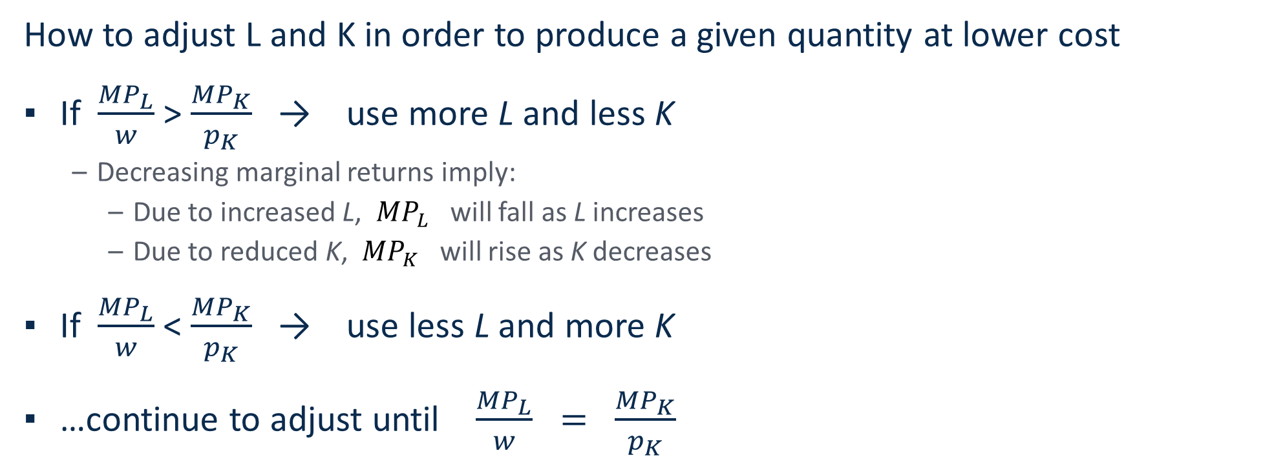
Module 3 · Long Run: The Optimal Input Mix
Applying the 'Bang for the Buck' Rule
('recipe' for exams)
How to adjust L and K in order to produce a given quantity at lower cost
If $\frac{{MP}_{L}}{w}$ > $\frac{{MP}_{K}}{p_{K}}$ → use more L and less K
Decreasing marginal returns imply:
Due to increased L, ${MP}_{L}$ will fall as L increases
Due to reduced K, ${MP}_{K}$ will rise as K decreases
If $\frac{{MP}_{L}}{w}$ < $\frac{{MP}_{K}}{p_{K}}$ → use less L and more K
…continue to adjust until $\frac{{MP}_{L}}{w} = \frac{{MP}_{K}}{p_{K}}$
Management 405 · Module 3 · Production and Costs
5
Notes:
Now the recipe for actually using the rule, the kind of thing worth having ready for an exam. Compare the two ratios, output per dollar on labor versus output per dollar on capital. If the labor ratio is higher, you are getting more output per dollar from workers, so shift toward labor, more workers and fewer robots. If the capital ratio is higher, shift the other way, toward more robots. Here is the nice part, the adjustment is self-correcting. As you add labor, diminishing returns pull the marginal product of labor down. As you pull back on capital, the marginal product of capital rises. So the two ratios move toward each other. You keep adjusting until they are equal, and that balance point is the optimal input mix.

Slide 6
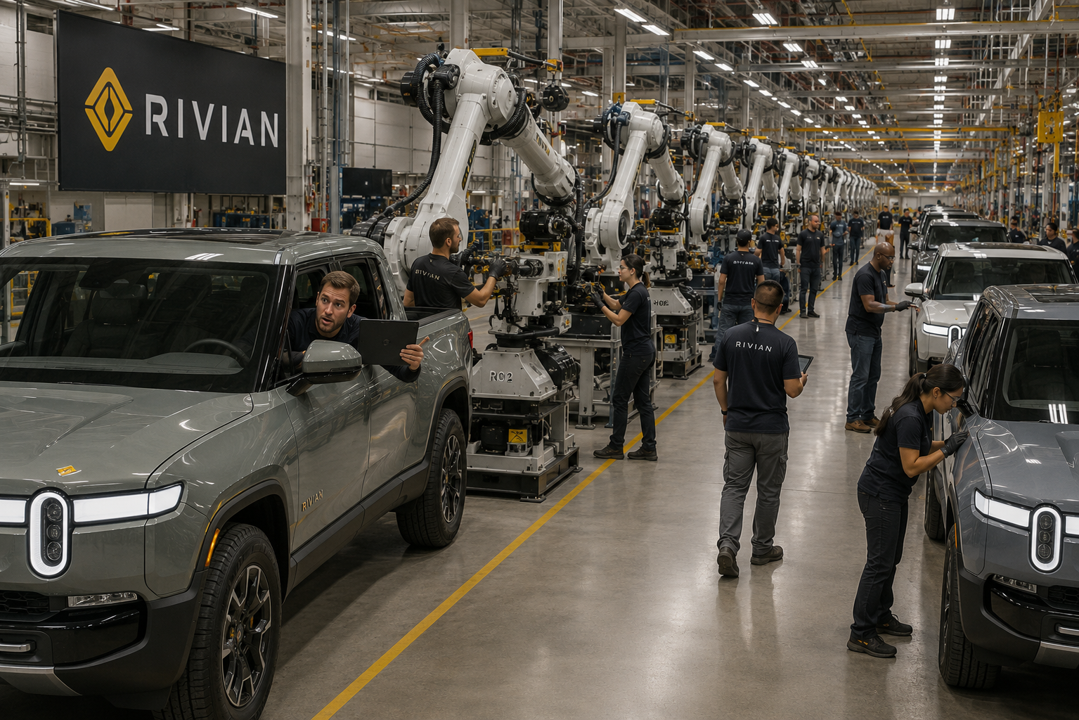
Module 3 · Long Run: The Optimal Input Mix
Example: Rivian's New Georgia Plant
Rivian is building a new plant in Stanton Springs, Georgia
They ask for your advice on the optimal mix of robots and workers
You know:
Current plan: 300 robots and 2,000 workers
Weekly wage for suitable workers: w = $1,200
Cost of one robot (per week): pₖ = $20,000
Is Rivian's 300 robots / 2,000 workers plan optimal?
Poll Break
Management 405 · Module 3 · Production and Costs
6
Notes:
Let's put the rule to work. Rivian is building that Georgia plant and asks for your advice on the mix of robots and workers. Here is what you know. Their current plan is 300 robots and 2,000 workers. A suitable worker costs about 1,200 dollars a week, and one robot costs about 20,000 dollars a week once you spread out its cost. The question for you is whether that 300-robot, 2,000-worker plan is actually the best mix. Take a moment with it before we work through the numbers.

Slide 7
Module 3 · Long Run: The Optimal Input Mix
Is Rivian's Current Plan Optimal? (Production Function)
The production function at Rivian's new plant:
Current mix: 300 robots, 2,000 workers
Let's derive the “ingredients” for the bang-for-the-buck rule
Convention: use the next-higher input level (Δ goes forward)
Labor: MP_{L} = ΔQ / ΔL = (571 − 534) / (2,500 − 2,000) = 0.07
Robots: MP_{K} = ΔQ / ΔK = (617 − 534) / (400 − 300) = 0.83
Now: Check if Rivian's proposed choice is optimal (PollEV)
K (robots)
 | 100 | 200 | 300 | 400
0 | 0 | 0 | 0 | 0
250 | 165 | 234 | 286 | 331
500 | 204 | 288 | 353 | 407
1,000 | 251 | 354 | 434 | 501
1,500 | 283 | 400 | 490 | 566
2,000 | 309 | 436 | 534 | 617
2,500 | 330 | 467 | 571 | 660
3,000 | 348 | 493 | 604 | 697
3,500 | 365 | 516 | 632 | 730
4,000 | 380 | 537 | 658 | 760
4,500 | 394 | 557 | 682 | 787
5,000 | 406 | 574 | 703 | 812
L (workers)
Rivian’s Production-function table
Poll Break
Management 405 · Module 3 · Production and Costs
7
Notes:
First we need the ingredients for the rule, the marginal products of each input at the current plan. Read the production table at 300 robots and 2,000 workers, and output is 534 cars. For the marginal product of labor, step up to the next level of workers, 2,500, holding robots at 300. Output goes from 534 to 571, so that is 37 more cars over 500 extra workers, a marginal product of about 0.07 cars per worker. For the marginal product of capital, step up to the next level of robots, 400, holding workers at 2,000. Output goes from 534 to 617, so that is 83 more cars over 100 extra robots, a marginal product of about 0.83 cars per robot. So one more robot adds a lot more output than one more worker. But before you conclude anything, remember the rule compares output per dollar, not output per unit, and robots are far more expensive. We settle it on the next slides.

Slide 8
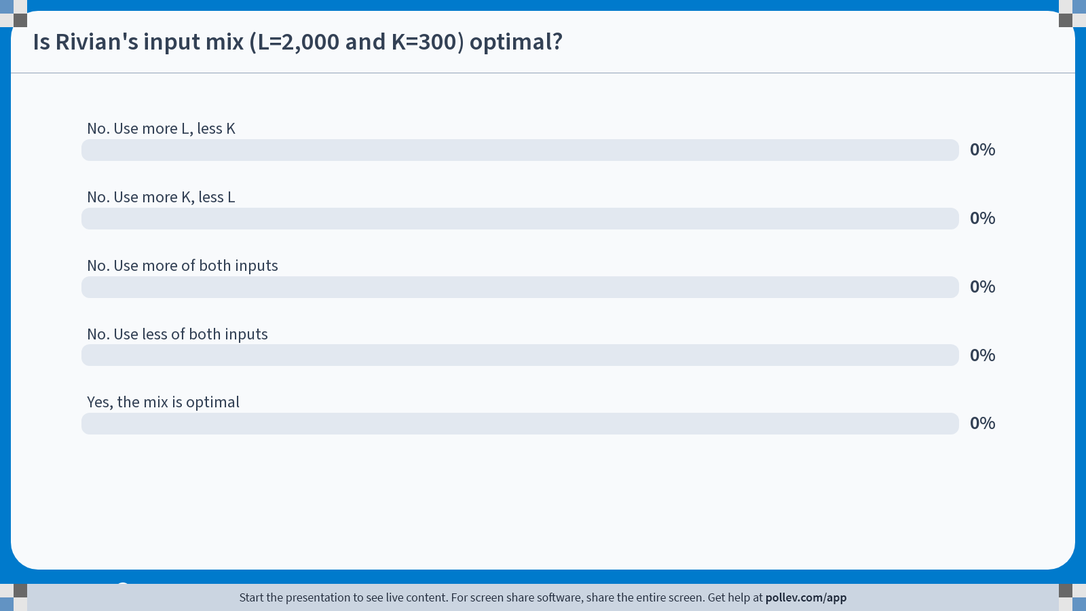
POLL
Notes:
Poll Title: Do not modify the notes in this section to avoid tampering with the Poll Everywhere activity. More info at polleverywhere.com/support Is Rivian's input mix (L=2,000 and K=300) optimal? https://www.polleverywhere.com/multiple_choice_polls/8O7ck3GbsDMnNFVZRfI6q?state=opened&flow=Default&onscreen=persist

Slide 9
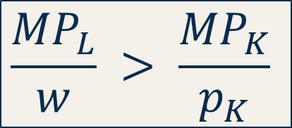
Module 3 · Long Run: The Optimal Input Mix
Solution: The Optimal Input Mix
MP
Price
MP per $
Robots (K)
≈ 0.83 cars
$20,000
0.000042 cars / $
Workers (L)
≈ 0.07 cars
$1,200
0.000058 cars / $
$$\frac{{MP}_{L}}{w} > \frac{{MP}_{K}}{p_{K}}$$
Thus:
→ Rivian should hire more workers, fewer robots in order to produce the same number of cars
Poll Break
Management 405 · Module 3 · Production and Costs
9
Notes:
Now we divide each marginal product by its price to get bang for the buck, the output per dollar. For robots, 0.83 cars divided by 20,000 dollars is about 0.000042 cars per dollar. For workers, 0.07 cars divided by 1,200 dollars is about 0.000058 cars per dollar. Line those up and the workers win. A dollar spent on labor buys roughly 1.4 times as much extra output as a dollar spent on robots. So the current plan is not optimal. Even though each robot produces more cars, robots are so much more expensive that they are the worse deal at the margin. The advice to Rivian is to hire more workers and use fewer robots, and to keep shifting until the two bang-for-the-buck ratios meet.

Slide 10
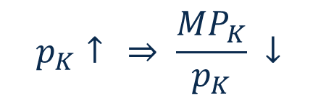

Module 3 · Long Run: The Optimal Input Mix
When Prices Change, the Input Mix Shifts
What's the effect on the optimal input mix if…
The government introduces a high tax on robots
Labor unions demand significantly higher wages
$$p_{K}↑ ⇒ \frac{{MP}_{K}}{p_{K}} ↓$$
$$w↑ ⇒ \frac{{MP}_{L}}{w}↓$$
→ shift toward more labor
→ shift toward more automation
When input prices change, the optimal mix shifts toward the input that has become relatively cheaper
Management 405 · Module 3 · Production and Costs
10
Notes:
One more thing the rule tells us, what happens when prices change. Suppose the government puts a heavy tax on robots. Robots just became more expensive per unit of output, so the mix shifts toward labor. Now suppose instead the unions win a big wage increase. Labor just became more expensive, so the mix shifts the other way, toward more automation. The general lesson is simple. When an input gets more expensive, you lean away from it and toward whatever is now the better deal. This is playing out right now inside AI labs deciding between spending on GPUs and spending on engineers, as the relative prices of those two keep shifting.

